Slide 1
Pseudoklasa dhe Box-shadow
Leksioni 03

Slide 2
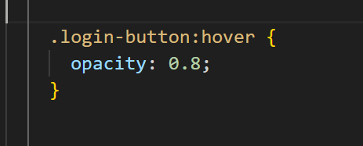
Hover

Slide 3
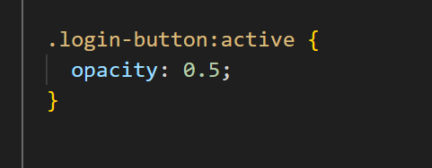
Active

Slide 4
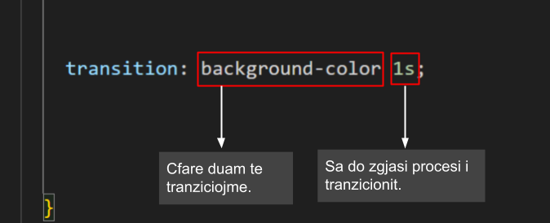
Transition

Slide 5
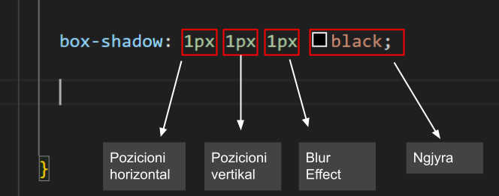
Box-shadow

Slide 6
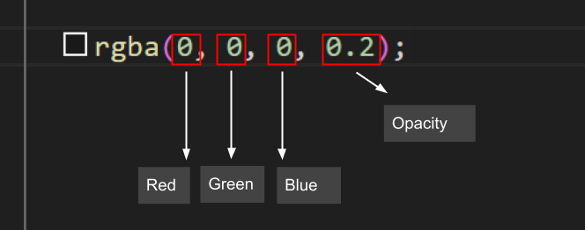
RGBA

Slide 7

https://sabian01.github.io/buttons/butonat.html

Slide 8
Ushtrime
Leksioni03

Slide 9
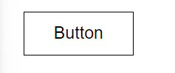
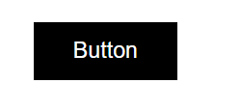
U1

Slide 10
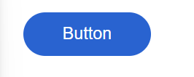

U2

Slide 11
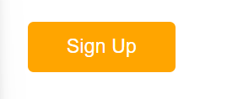

U3

Slide 12


U4

Slide 13


U5

